Slide 1
Chapter 4 – CI-CD with Jenkins

Slide 2
Learning Topics
Overview of Jenkins
Jenkins Jobs
Overview of Continuous Integration
CI with Jenkins
CI-CD with Jenkins

Slide 3
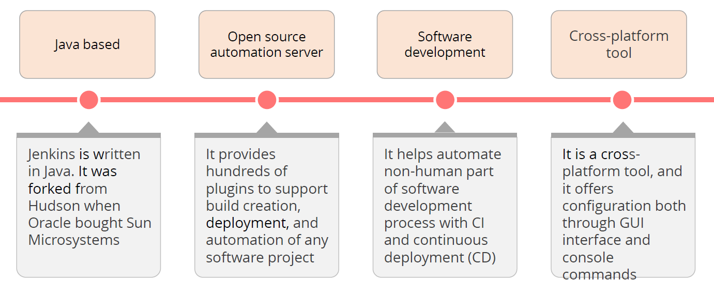
Jenkins

Slide 4
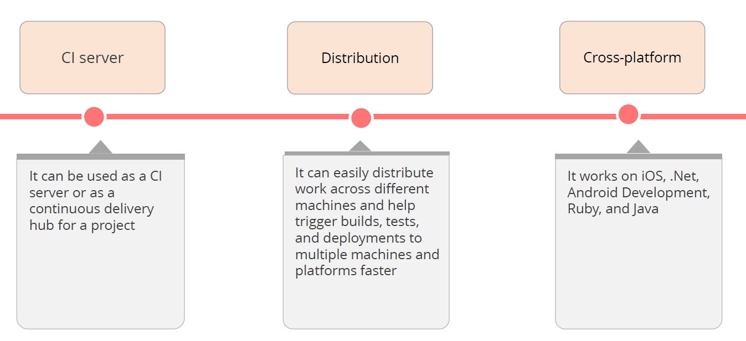
Jenkins Cont.

Slide 5
Jenkins Lab – Pre-requisites
2 Servers available with Jenkins Installation
Login to Jenkins Console
Please Don’t Delete Anything
Please Don’t Modify System Configurations

Slide 6
Jenkins Lab 1 – First Job – Free Style

Slide 7
Jenkins Lab 2 – Parameterized Job

Slide 8
Jenkins Lab 3 – Email Notifications

Slide 9
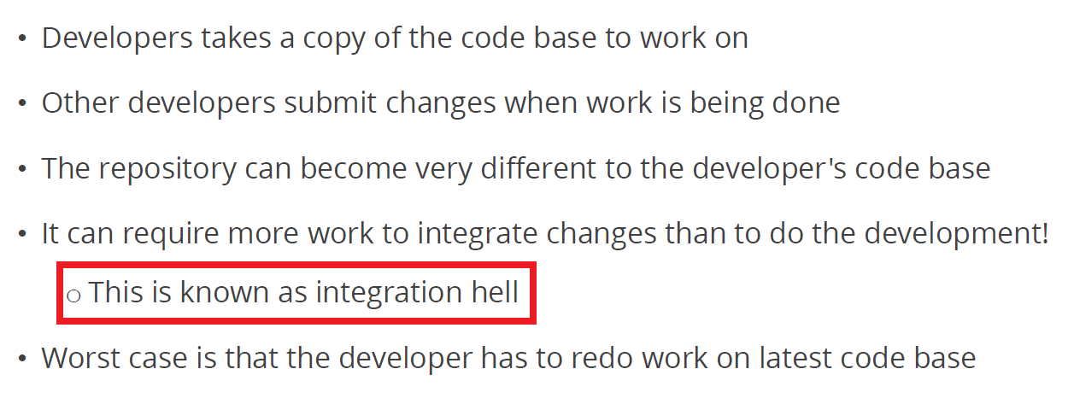
Integration Hell

Slide 10
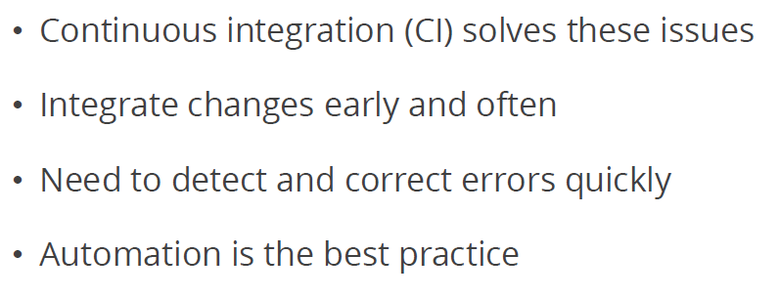
Continuous Integration (CI)

Slide 11
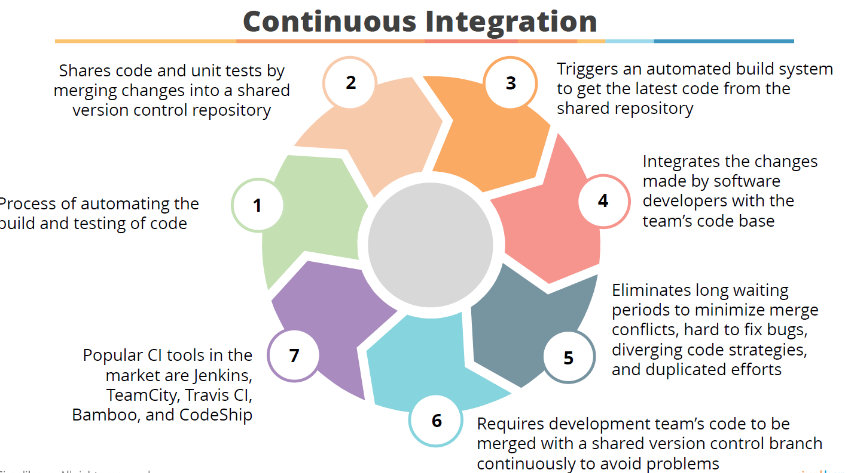

Slide 12
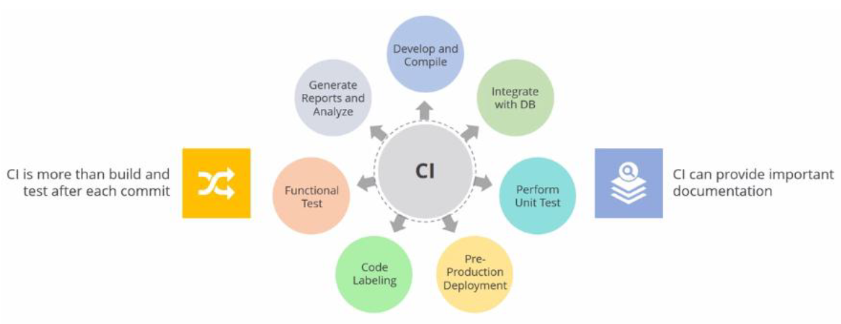
Continuous Integration Cont.

Slide 13
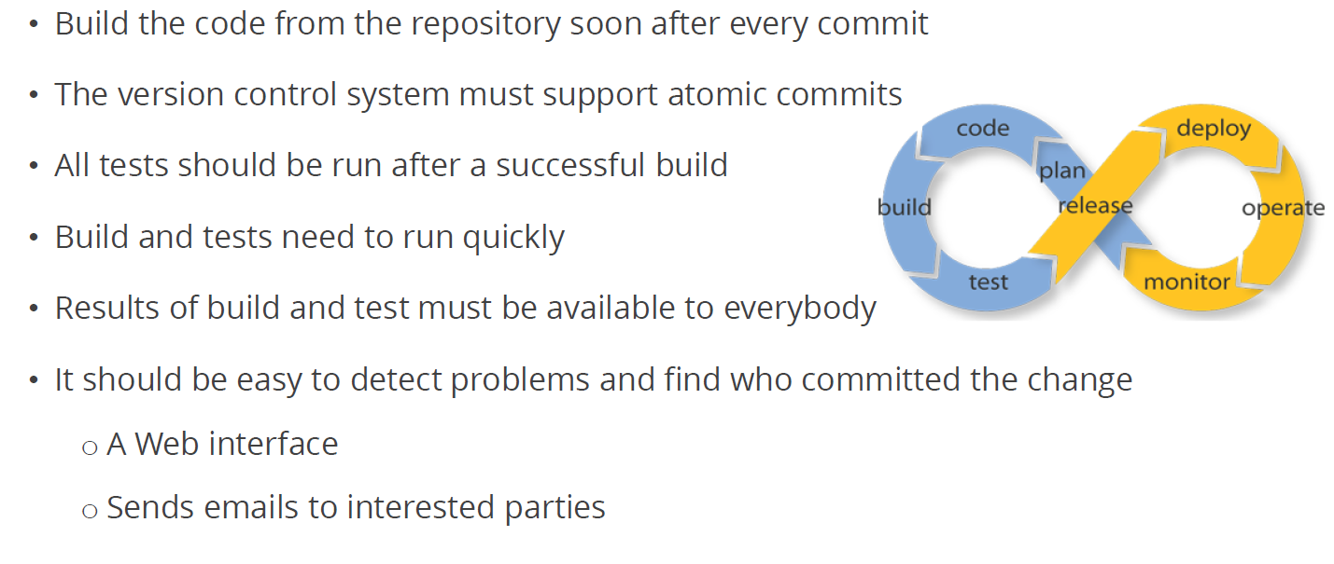
Continuous Integration Tools

Slide 14
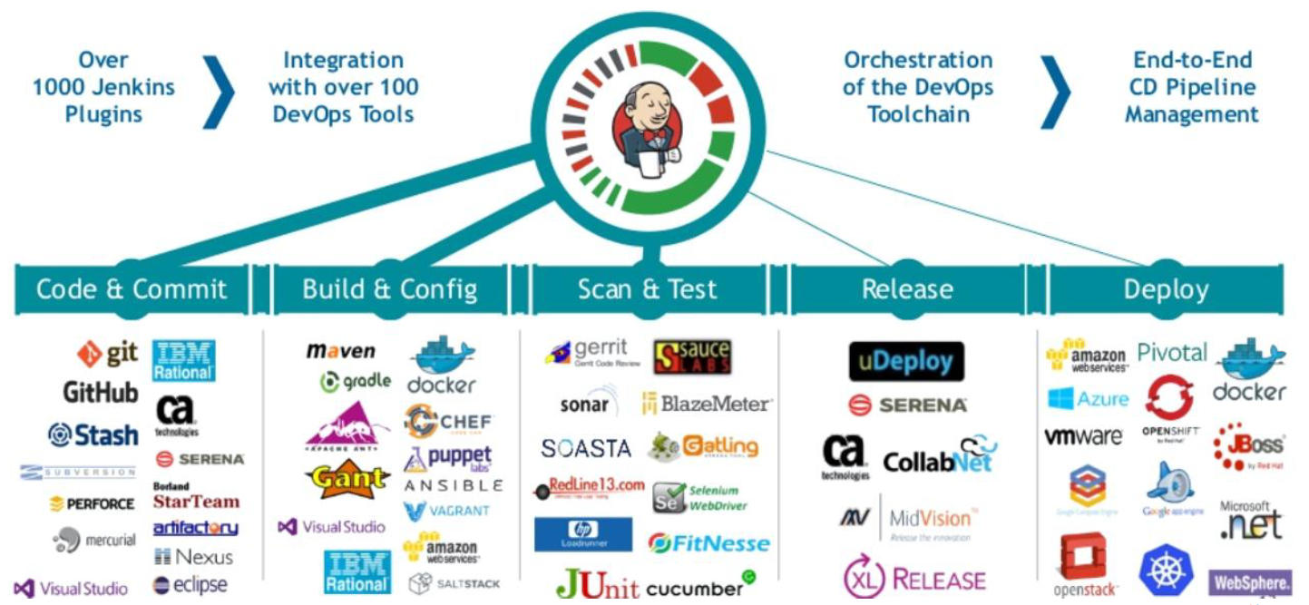
CI Using Jenkins

Slide 15
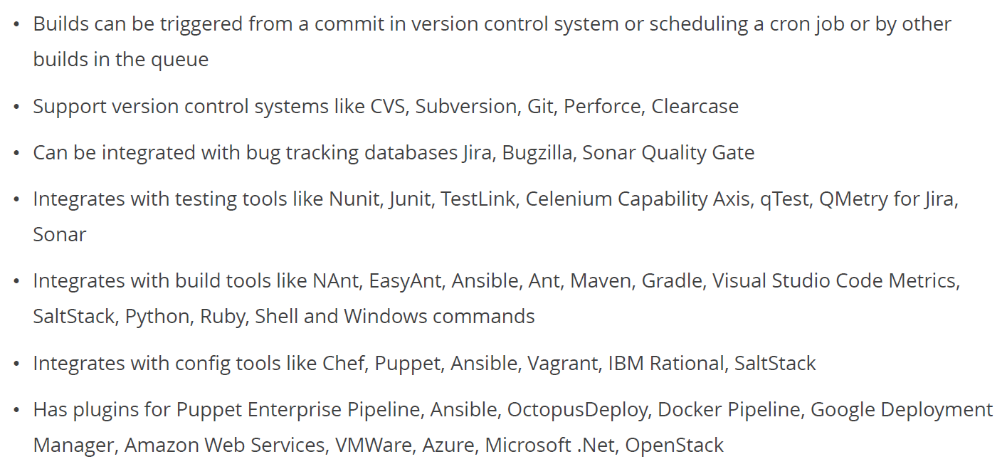
CI Using Jenkins

Slide 16
Jenkins Lab 4 – CI & Webhook

Slide 17
Group Assignment – CI with GitHub
Team of 2
Team Leader and Team Members
Team Leader to create repo
Add Team Members as Collaborators
Team Members to clone repo
Create their own branch (use your name)
Create New File
Push to GitHub
CI with Jenkins (Create One Job for One Repo)
Email Notifications for All Team Members

Slide 18
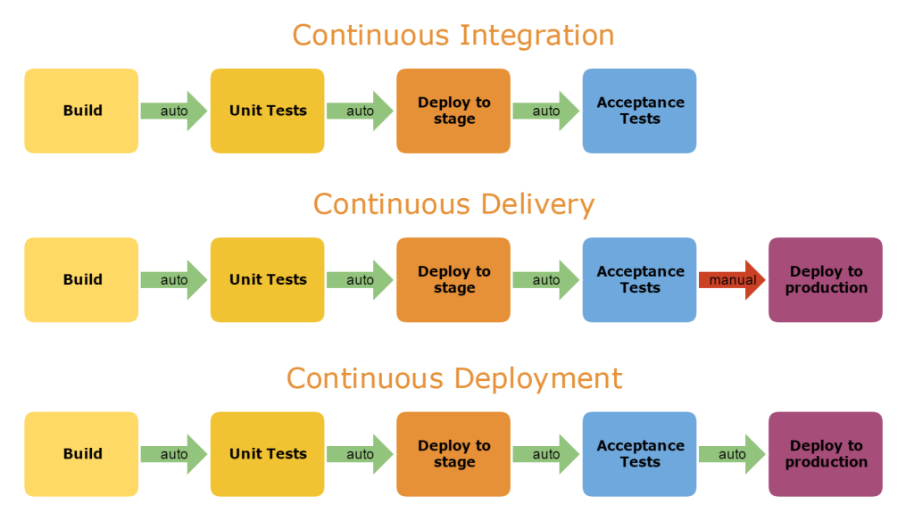
CI-CD-Continuous Deployment

Slide 19
Jenkins Lab 5 – Continuous Deployment

Slide 20
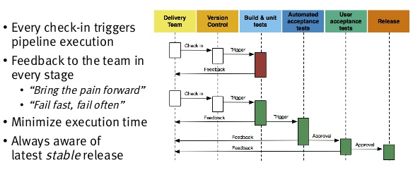
Jenkins Pipelines

Slide 21
Jenkins Lab 6 – Pipelines

Slide 22
Individual Assignment
Create pipeline for all your jobs ( 5 jobs)
Trigger first job from GitHub

Slide 23
This concludes Chapter 4 Let us move to Chapter 5 Containerization with Docker

